Slide 1

Multi-Report
Quick Start Guide
Version 3.20
10 September 2025

Slide 2
What is Multi-Report?
Multi-Report was written a long time ago under a different name, with the purpose of augmenting FreeNAS 8.x (and beyond) for running SMART tests, and monitoring for drive failures as FreeNAS was not very good at it reliably.
One major change has occurred in version 3.1, the S.M.A.R.T. testing has been removed from Multi-Report and moved into a companion script called “Drive_Selftest”. This makes maintaining the script easier and the Drive_Selftest script can run on its own for those people who just want to run the smart tests easily and not receive a report.
SMART was designed with the intention to warn a user of pending Hard Drive doom within 0 to 24 hours of a failure. This is not fool proof, not a magic bullet. SMART is not perfect however if it does predict a failure and you are aware of it, you can fend off some danger. There are some failures that cannot be predicted and some failures happen very fast. All the data provided by this script will assist you moving forward once a failure or indication of a pending failure is identified.
Additionally, I highly recommend running a SMART Short test once a day and running a SMART Long test once a week. If you have a lot of drives, only schedule a few drives a day (Monday), a few others (Wednesday), you get the point. The new Drive_Selftest can automate the scheduling of your SMART tests, example: Daily Short tests and Weekly or Monthly Long Tests, and it is very simple to setup.
As you look at the chart data, note that the column titles should be self-explanatory.
Pay attention to the CRON setup between CORE and SCALE, they are different.

Slide 3
Quick Setup Information
Setting up the CRON JOB
(CORE) -> Tasks -> Cron Jobs -> ADD
(SCALE) -> System -> Advanced -> Cron Jobs -> ADD
Description: multi_report
Command (CORE): ./mnt/pool/scripts/multi_report.sh
Command (SCALE): cd/mnt/pool/scripts && ./multi_report.sh
Run As User: root (or any privileged account)
Schedule: Custom
  Preset: Daily
  Minutes: 0, Hours: 2, Days: *
  Select DONE
Hide Standard Output: Unchecked
Hide Standard Error: Unchecked
Enabled: Checked
Save
Place script on your server (location is for example only)
Create a new dataset titled ‘scripts’. Path: /mnt/pool/scripts
  Make the dataset:
    Name: scripts
    Share Type/Dataset Preset: SMB
    SCALE: Create SMB Share checkbox
    Submit/Save
You should now have access to the SMB share you created.
Copy the script to the ‘scripts’ dataset, rename the script to “multi_report.sh”.
Make the script executable: “chmod +x multi_report.sh” (must be `root`)
3
1
2
First and Second Run
As a privileged user (root), open a shell/SSH window and change directory ‘cd’ to cd/mnt/pool/scripts
First Run: Enter ./multi_report.sh -config
  Follow the instructions to create a new multi_report_config.txt (configuration file).
Second Run: Enter ./multi_report.sh
  The script should run without error.
4
Notes:
To customize Multi-Report run the script with the ‘-config’ switch and select Advanced Configuration.
If you run into a real problem, search the TrueNAS forums first, and if you cannot figure it out, use the ‘-dump email’ switch to send me the required information I need to assist you. I will return an email to you once I have looked at it. I normally get back to people in less that 24 hours, keep in mind time zones, I’m in the USA, NY (ET).

Slide 4
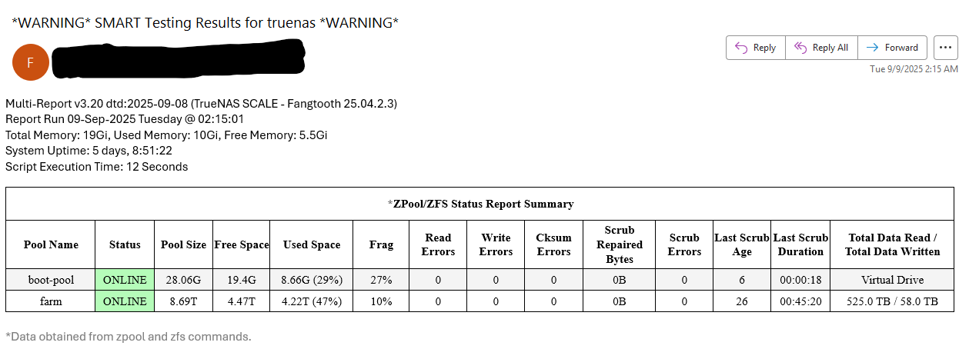
Anatomy of the Multi-Report Email
Subject Line with Summary (Warning, Caution, Script Update Available, or Custom)
Version Info
Date/Time of Report
RAM/SWAP Specs
Uptime
Run Duration of the Script
Updates if available
Total Lifetime Data Values for all the drives in a pool.

Slide 5
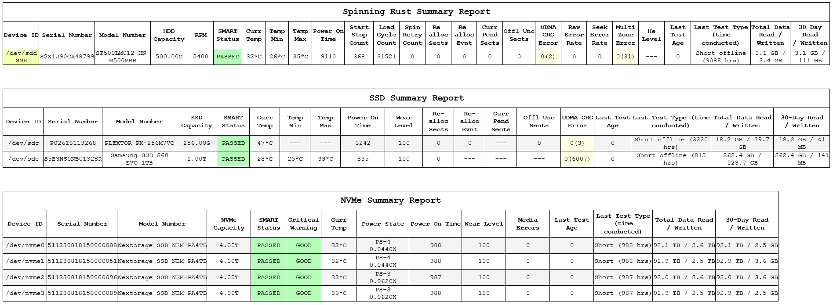
Anatomy of the Multi-Report Email
“0” = Compensated Value
“(2)” = Real Value, Yellow = Alarm Override
Purpose: To easily identify new alarms
30 Day Rolling Average, can be set to Calendar Month
SMR Checking
Yellow = Alarm Override
Total Lifetime Data Read or Written to the drive
The power state of the NVMe when the script is near completion
“---” means No Value is available for this drive
How many 24 hour periods (value is based on 24 hours) have past since last S.M.A.R.T. test
A Short S.M.A.R.T. Test Completed
(987) Hours the test completed. If the last test was a Long test, that would be indicated here

Slide 6
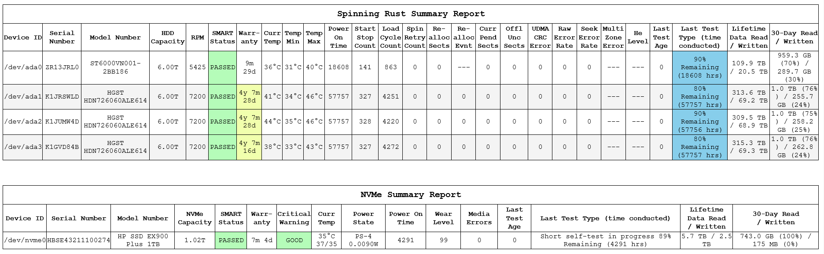
Anatomy of the Multi-Report Email
Warranty Remaining
Warranty Exceeded (Yellow Background)
Total Lifetime Data Read or Written to the drive
“---” means No Value Exists
(xx%) is the percentage of Writing to Reading for the given period of time

Slide 7
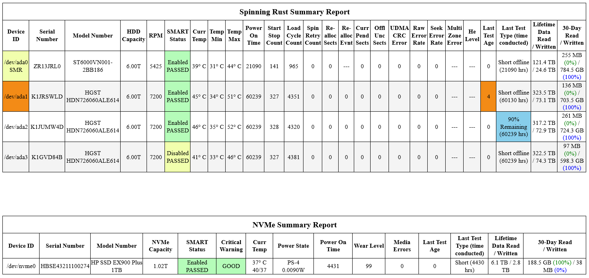
Anatomy of the Multi-Report Email
(Version 3.20 Changes)
SMART Enabled/Disabled Status and PASSED/FAILED results
User changeable fonts
NVMe Reports Min/Max Temps since power on, if available
Added a little color

Slide 8
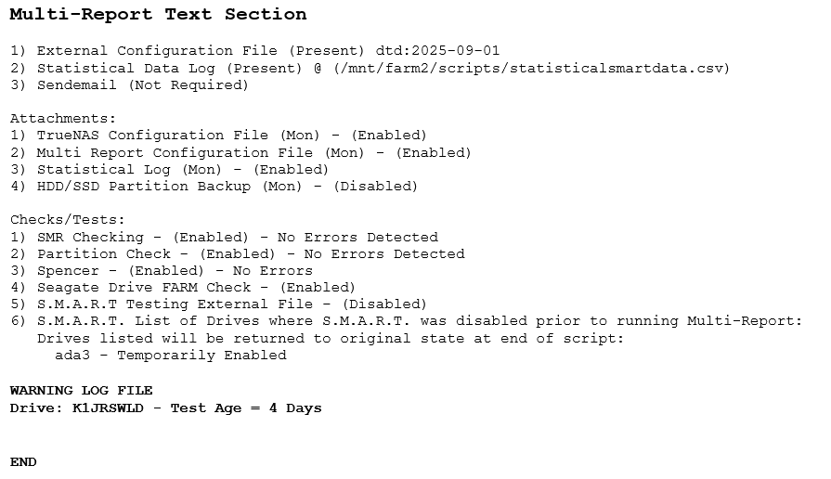
Anatomy of the Multi-Report Email
The Text Section contains:
Configuration Information and
Test Information
SMART Drive Status (New)
Update and Error Logs
Three logs can be displayed, Caution, Warning, and Update.
If you have an alarm on the Chart Section, look here for amplifying information.

Slide 9
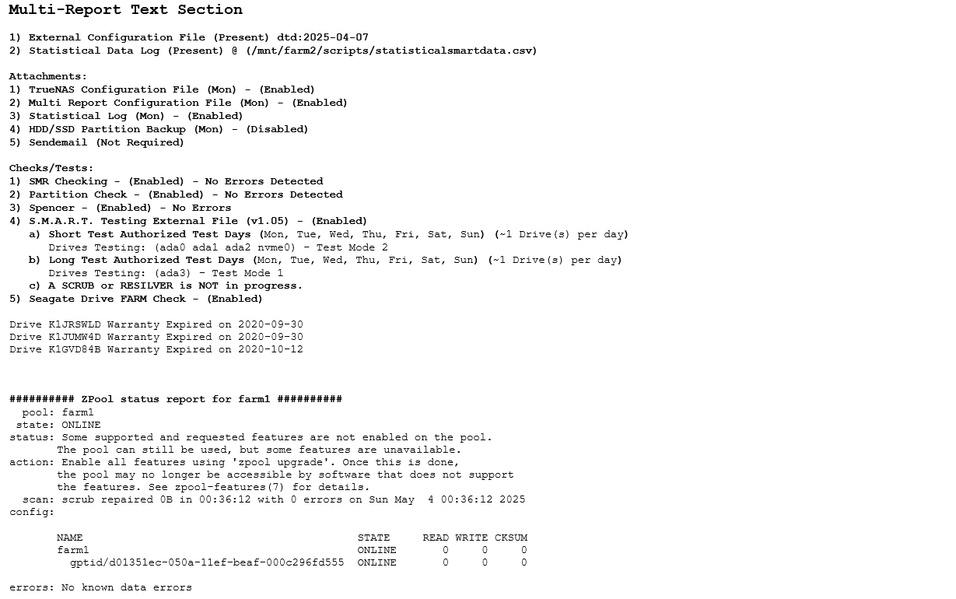
Anatomy of the Multi-Report Email
List of attachments that will be included during a Monday (default) run.
Sendemail is used or not used.
If SMART Testing is enabled:
List of drives being Short and Long tested this run.
Also report if a SCRUB or Resilver operation is in progress as these operations by default will not allow a SMART Long test to be run.
Seagate Drive FARM Check
This may be disabled if you have already run the check and it will slightly speed up the script.
If Warranty is enabled and when the drives have expired, the drives will be listed with the expiration date.
The Chart section will display a countdown or count-up (yellow background) as well.

Slide 10
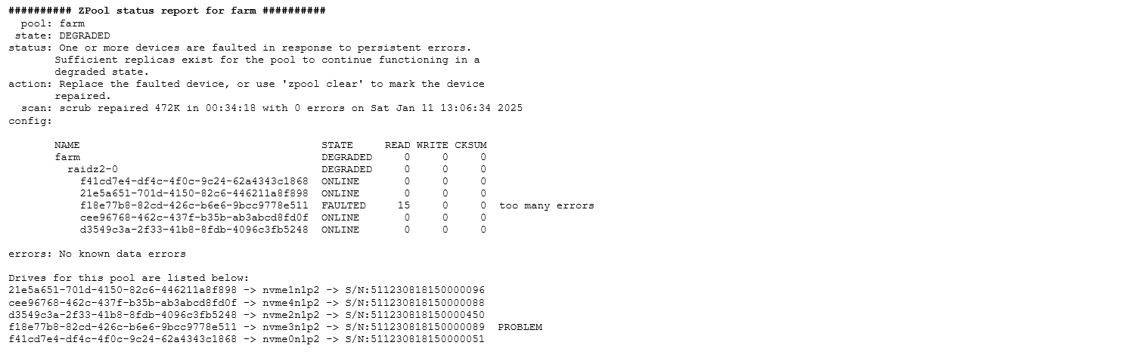
Anatomy of the Multi-Report Email
Zpool Status
Besides the standard zpool status data, this example tells you the drive is “Virtual”, the gptid number, the Drive ID, and Drive Serial Number.
Use this cross reference data to locate the drive serial number and use the drive serial number when troubleshooting a drive problem.
All drives for pool called “farm” in this example
identified by three things:
gptid -> Drive ID -> Drive Serial Number
This makes it significantly easier to identify which drive actually failed by serial number.
PROBLEM does not mean the drive has fail. It simply means that a problem is related to this physical drive. It could be a ZFS problem (as in this example) or a real hardware failure. Just do not jump to conclusions without looking at all the data.

Slide 11
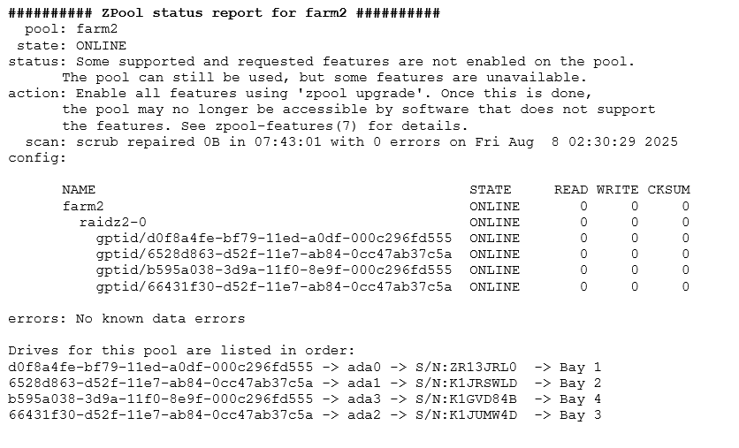
Anatomy of the Multi-Report Email
New for Version 3.20
Drive Location Data
(Great for locating your drive’s physical location)

Slide 12
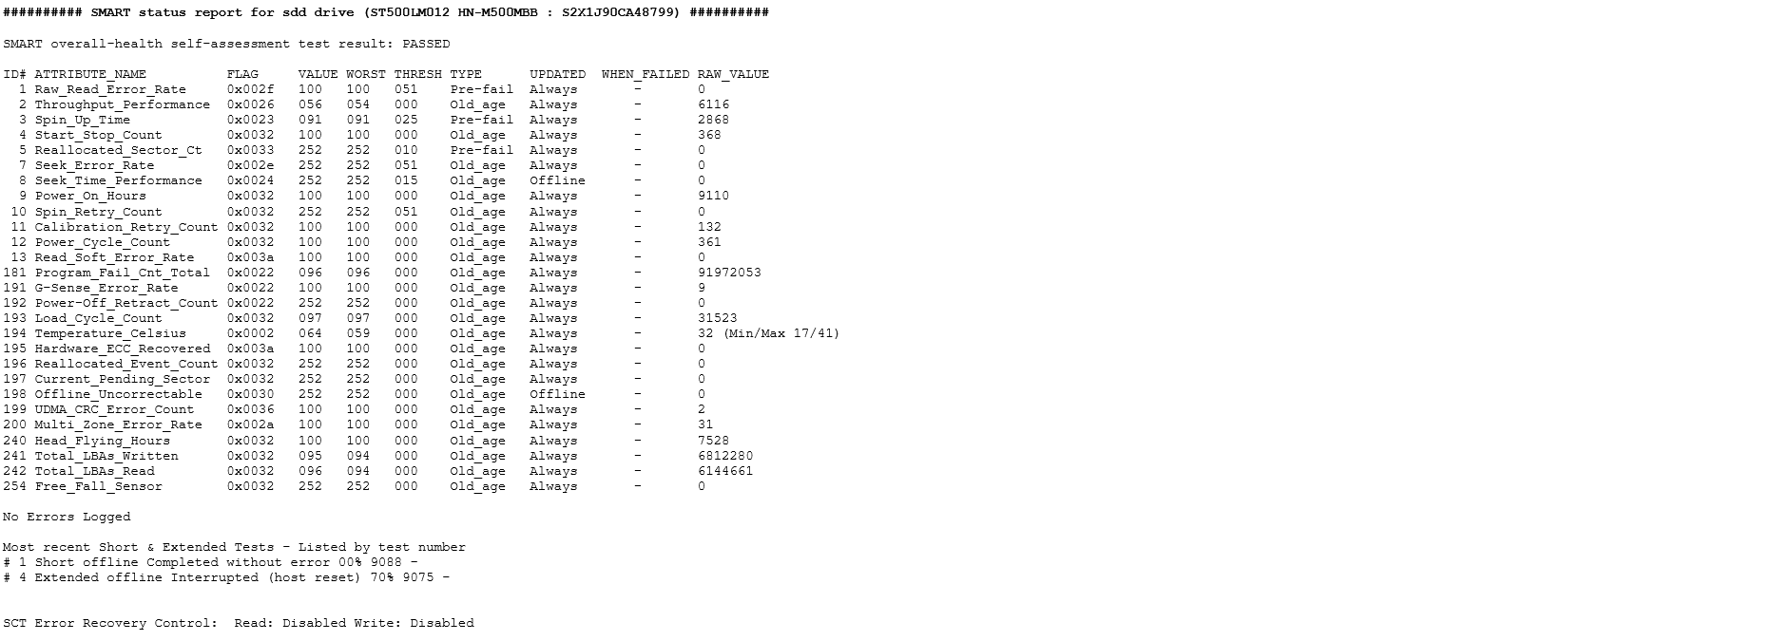
Anatomy of the Multi-Report Email
Header to identify the report is for Drive ID ‘sdd’ and lists the Model Number and Serial Number
The OUTPUT of “smartctl –a”
Why did I include this in the report you ask?
Because it is the information at the time of the report. Data can and will change so we grab it here should there be a problem to examine.
Seagate ID1 and ID7 will read the true error rates, no more number conversion.
(New Ver 3.20)
The Last SMART Short and Long Tests
with the results.
TLDR Can also be set by the script, the default is 70 (7.0 seconds) when enabled. It is Disabled in this example.

Slide 13
Closing Notes
Always backup your important data
Always use an Uninterruptable Power Supply (UPS)
Read the User Guide
If something is not running correctly, please ensure your CRON Job setup is like the example in the Quick Setup Information. Having the wrong command can absolutely cause problems. If you are smarter than me, share your wisdom, I will accept it openly. Having the “Hide Standard Output” unchecked provides additional data when the script is run. If you filter your emails and place these into a separate folder, it will keep your email looking clean and consolidated.
This Quick Start Guide is not an “all inclusive” resource. I will not cover every possible problem a drive could indicate, that is not the purpose of the guide. If you have something happen and it is not covered here, try to use Google to find out more, or ask someone. It can be much faster for you if you Google it.
If you find something wrong with the script or these instructions, please reach out to joeschmuck2023@hotmail.com with the issue, or run the script using the ‘-dump email’ switch to send me data to analyze and include a little message as well. Believe it or not, I appreciate the feedback, good or not so good.
And if you have a recommendation on what the default values should be within the multi_report_config.txt file, please reach out to me. If the change makes sense, I will implement it.

